Slide 1
TEAS: Test of Essential Academic Skills
Dawn Davis, M.Ed.
Student Success Coach

Slide 2
What does the TEAS exam consist of?
The format of the TEAS test is similar to other standardized tests you’ve likely taken in your life and shouldn’t throw you for a loop.
The TEAS test consists of 170 multiple-choice questions.
You will have 209 minutes to complete the test.
According to the Assessment Technologies Institute (ATI)

Slide 3
What do I need to know to pass the TEAS test?
The bulk of what you’ll need to know for the TEAS test is tied to the foundational education subjects commonly found in high school curriculums.
ATI shares that the test covers material in the following areas: Reading, Math Science, and English

Slide 4
What is the question breakdown?
Reading: Questions: 53 Allotted time: 64 minutes. Areas assessed: key ideas and details, craft and structure, and integration of knowledge and ideas.
Mathematics: Questions: 36. Allotted time: 54 minutes. Areas assessed: numbers, algebra and data interpretation and measurement.
Science: Questions: 53. Allotted time: 63 minutes. Areas assessed: human A&P, life and physical sciences, and scientific reasoning.
English: Questions: 28 Allotted time: 28 minutes. Areas assessed: conventions of Standard English, knowledge of language and vocabulary acquisition.

Slide 5
How should I prepare for the TEAS test?
The TEAS test is important, which is why you shouldn’t take studying lightly. If you want to pass it on your first attempt, then you should plan on devoting some time and energy into preparing.
Take the TEAS test early
Register at least two weeks ahead of time
Utilize the ATI resources (More on Next Slide)
Review the fundamentals

Slide 6
ATI Resources

Slide 7
This is a resource I am providing for you to get a feel for what you will be expected to know and do in regard to reading skills.

Slide 8
TEAS Reading Tips
The questions are often preceded by a long or short passage. It is helpful to read the questions first and then read the passage. This will give you an idea of what to focus on when reading the passage.
You will often see questions beginning with “logically conclude.” This is a trap! Don’t be tempted to make assumptions about the text based on your own personal understanding—try to keep to the facts in the text.
Many questions will focus on your ability to determine the difference between opinion and fact. These questions can be tricky if you are not used to them, so practice recognizing the difference between fact (the sky is blue) and opinion (the sky is pretty)

Slide 9
TEAS Reading Tips Cont.
Familiarize yourself with different writing styles, such as persuasive and informational writing styles.
Try to improve your reading speed and comprehension in advance. You want to ensure that you can finish the section before the time is up. Manage your time! Make sure you pace yourself.
Practice at home with TEAS practice reading materials, and estimate how much time you need to allot to each question.
Pay attention to the wording in questions. The wording in the question itself will usually provide helpful hints that can lead you toward the correct answer.

Slide 10
PRACTICE QUESTIONS

Slide 12
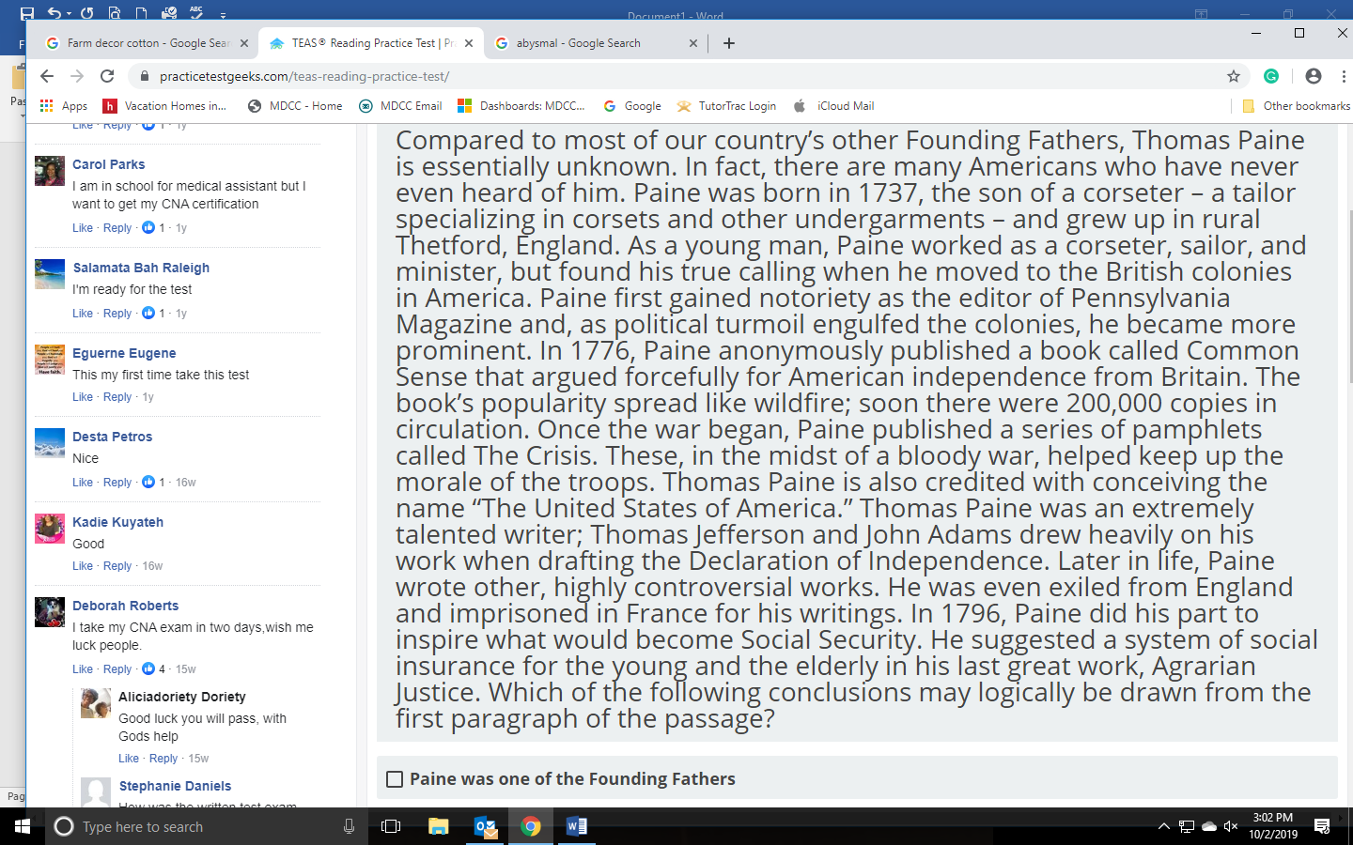

Slide 16
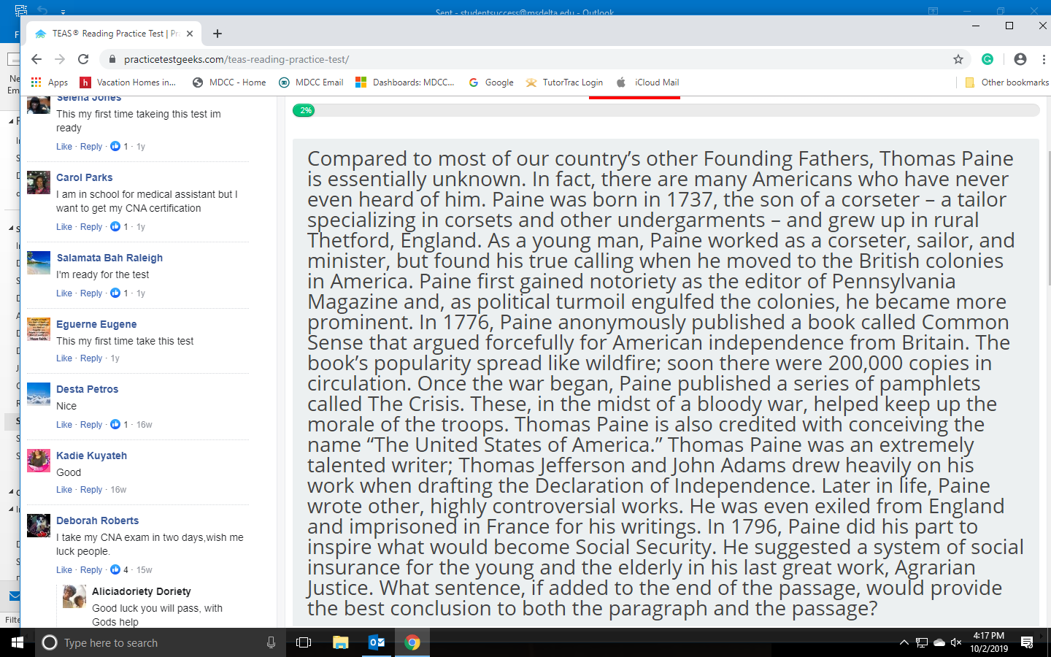

Slide 18
This is a resource I am providing for you to get a feel for what you will be expected to know and do in regard to English skills.

Slide 19
TEAS English Tips
STEP 1: ANALYZE THE INFORMATION PROVIDED.
Many questions about English and language usage will present you with a sentence or short passage and ask you to identify an element of the sentence, complete the sentence correctly, or fix an error. The question will specify what task you are to perform. Read the question and the sentence carefully
Not every question is accompanied by a sentence. Some simply ask you to recall facts. However, the question still contains key terms that you need to apply. The TEAS test has many language arts topics; you might see a question about writing style followed by one about punctuation followed by one about sentence structure. Each time you read a question, give yourself the time it takes for one deep breath to call to mind the particular rules or facts being tested.

Slide 20
TEAS English Tips
STEP 2: PREDICT THE ANSWER.
Before looking at the answer choices, predict the answer. You have a much better chance of finding the correct answer if you already have it in mind. Sometimes you may not be able to make a specific prediction, depending on the question.
Alternatively, you may have trouble thinking of the exact answer. If the question asks for the part of a book that lists key terms alphabetically. You may not be able to think of the word index right off the bat, but you may know that you find this list at the back of a book. Even an approximate prediction will allow you to eliminate answer choices you know are not found at the end of a book.

Slide 21
TEAS English Tips
STEP 3: EVALUATE THE ANSWER CHOICES.
Compare each answer choice to your prediction, eliminating those that are not a match and choosing the one that is a match.

Slide 28
Tips for Managing Stress of the Test
CLOCK IN AND OUT Set up a study schedule for yourself, and treat it like a job.
DON’T PUNISH YOURSELF
If you get tired or overwhelmed or discouraged when studying, don’t respond by pushing yourself harder. Instead, step away and engage in a relaxing activity like going for a walk, watching a movie, or playing with your cat or dog. Then, when you’re ready, return to your studies with fresh eyes.

Slide 29
Tips for Managing Stress of the Test
SET SMALL, MANAGEABLE GOALS
Each week, set manageable goals for your TEAS progress. Then reward yourself when you’ve achieved them. Examples of small goals might be:
This week, do 20 math questions and practice each until I can move confidently and efficiently from the information provided to the correct answer.
This week, review all the spelling rules that the TEAS is likely to test until I can identify words that use them and words that are common exceptions.

Slide 30
Tips for Managing Stress of the Test
KEEP YOURSELF HEALTHY
Good health, adequate rest, and regular interactions with friends and family make it easier to cope with the challenges of studying. Stay on a regular sleep schedule as much as possible during your studies, eat well, continue to exercise, and spend time with those you care about and those who help you feel good about yourself. Also, don’t fuel your studies with caffeine and sugar. Those substances may make you feel alert, but they can also damage focus.

Slide 31
Tips for Managing Stress of the Test
REMIND YOURSELF WHY YOU ARE DOING THIS
If you feel tempted to pass up a planned study session because you’re tired or something comes up that feels like a higher priority, remind yourself how important a good score on the TEAS is. Success on this test will open the doors to an important educational credential and many career opportunities after that. If you planned to study for 90 minutes and don’t think you can study for that long, then study for 30 minutes. You will make progress toward the score you want, and you will feel better about yourself than if you “blow it off.” You may even be surprised at how fast the 30 minutes go by and decide that you can study longer after all.

Slide 32
Tips for Managing Stress of the Test
KEEP THE RIGHT MINDSET
Most importantly, keep telling yourself that you can do this. Don’t fall into the trap of thinking that you’re not “allowed” to feel confident yet. That’s a self-punishing attitude that will only hurt you. Rather, remember that confidence breeds success. So let yourself be confident about your abilities. You’re obviously ambitious and intelligent, so walk into the TEAS knowing that about yourself.

Slide 33
Tips for Managing Stress of the Test
IF YOU GET DISCOURAGED, MAKE A LIST
If you start to wonder if you’ll ever reach your TEAS goals, stop what you’re doing and make a list of everything you’re good at. Here are some examples:
· Finding the main point of a passage · Using commas correctly in lists. · Naming the organ systems of the human body · Explaining how oxygen reaches tissues in the body
Post that list of things you’re good at somewhere you’ll see it every day and add to it as you continue to study. It will be a long list in no time! There are TEAS skills you’re good at. Keep that in mind and focus on building on those strengths.

Slide 34
Don’t Spend All Your Time Creating Study Materials

Slide 35
THE WEEK BEFORE TEST DAY
REST
Make sure you’re on a regular sleep schedule.
REHEARSE
Find out where you will be taking the test and consider doing a “dry run” if you will be commuting. You don’t want to be surprised by traffic or road construction on Test Day. You also don’t want to get delayed or stressed out trying to figure out where to park, which way to go to the building, or where the restrooms are.

Slide 36
THE WEEK BEFORE TEST DAY (Continued)
REVIEW
Flip through the lessons and rework a few practice problems here and there to reinforce all of the good habits you’ve developed in your preparation.
STOP
Two days before the test, stop studying. You’re not likely to learn anything new in those two days, and you’ll get more out of going into the test rested.
RELAX
The evening before the test, do something fun (but not crazy or tiring). Maybe you could have a nice dinner (without alcohol), watch a movie, catch up on housework (a clean house is relaxing for some people).

Slide 37
THE WEEK BEFORE TEST DAY (Continued)
GO TO BED, GO TO BED, GO TO BED!
Go to bed early enough to get a full night’s sleep (7–8 hours) before the day of the exam.

Slide 38
How To Test
All TEAS Exams will be Remote Proctored (Virtual). You must meet certain technical requirements to take this exam remotely. Please ensure that you are able to meet the following technical requirements.

Slide 39
Technical Requirements
Please ensure that you are able to meet the following technical requirements:
Microphone: Any microphone either internal or external
Webcam: 320x240 VGA resolution (minimum), internal or external
Desktop or Laptop Computer - No iPads, tablets or phones are to be used.
Google Chrome web browser
If you cannot meet these technical requirements listed, please contact our office to make alternate arrangements for testing.

Slide 40
Cost and Registration
The cost of the TEAS test is $87.00 and is payable only by debit or credit card at the time you register. The last day to register is 72 hours before your desired test date.
To register for testing, please visit: www.atitesting.com.

Slide 41
Not The Best Strategy

Slide 42
Test Day
After weeks of preparation, you know what to expect on the TEAS. You’ve studied a lot and taken a test practice test or two. Now your Test Day is approaching. How can you make sure you do your best?
Arrive at least 15 minutes early so the proctor can verify your identity and get you checked in. Proctors will monitor you throughout the test, and they will intervene if they observe disruptive behavior.

Slide 43
WARM UP
Before the test do a warm-up. This will help your brain get ready to function at its best. Don’t take any practice materials into the testing center, but do a few practice questions at home or work before you go in for the test.
DON’T LET NERVES DERAIL YOU
You have every reason to feel confident. You have prepared for this test! If you find yourself getting nervous or losing focus, sit back in your seat and place your feet flat on the floor. Take a few deep breaths and close your eyes or focus them on something other than the computer screen or test booklet for a moment. Remind yourself that you have studied diligently and are ready, then reengage with the test.
TEST DAY (Continued)

Slide 44
TEST DAY (Continued)
Note that during the test, if you need to leave for any reason, you must raise your hand and be excused by the proctor. While you are out of the room, the timer will continue to count down; any time you miss cannot be made up. If you need the proctor’s assistance for any other reason, such as a technical malfunction with your computer, raise your hand. Finally, if you find the test setting uncomfortable or inadequate, report your concern to the proctor before leaving the room at the end of the test.

Slide 45
TEST DAY (Continued)
KEEP MOVING
Don’t let yourself get bogged down on a question. You can come back to questions that you aren’t sure about, so skip questions that threaten to slow you. There is no penalty for a wrong answer on the TEAS, so make sure to answer every question before time is called, even if you have to guess on some questions.
SELECTING/GUESSING
Use the multiple-choice format to your advantage: if you can eliminate one or two answer choices as wrong, you greatly increase your chance of getting it correct.

Slide 46
TEST DAY (Continued)
DON’T ASSESS YOURSELF
This is very important. As you’re testing, don’t let yourself stop and think about how you feel you’re doing. Taking a standardized test hardly ever feels good. Your own impressions of how it’s going are totally unreliable. So, instead of focusing on that, remind yourself that you’re prepared and that you are going to succeed, even if you feel discouraged as the test is underway.

Slide 47
TEST DAY (Continued)
Note that during the test, if you need to leave for any reason, you must raise your hand and be excused by the proctor. While you are out of the room, the timer will continue to count down; any time you miss cannot be made up. If you need the proctor’s assistance for any other reason, such as a technical malfunction with your computer, raise your hand. Finally, if you find the test setting uncomfortable or inadequate, report your concern to the proctor before leaving the room at the end of the test.

Slide 48
AFTER TEST DAY
After the test, celebrate! You’ve prepared, practiced, and performed like a champion. Now that the test is over, it’s time to congratulate yourself on a job well done. Celebrate responsibly with friends and family and enjoy the rest of your day, knowing you just took an important step toward reaching your goals

Slide 49
Additional Resources
Web Sites and Study Options
Quizlet – flashcards, practice, etc. https://quizlet.com/subject/ATI-TEAS-6-study-guide/ (Plus others if you search)
The Adkins Academy Inc. https://adkinsacademy.com/teas-v/?gclid=EAIaIQobChMIjpGY1c2S5QIVBj0MCh1LPgjwEAMYAyAAEgLVCfD_BwE
Test Guide https://www.test-guide.com/free-teas-practice-tests.html
Practice Test Geeks. https://practicetestgeeks.com/ati-testing-online-teas-practice-test/?utm_source=grs&gclid=EAIaIQobChMIq5Ka2c6S5QIV1PfjBx0zGQ4NEAAYAyAAEgLfHfD_BwE

Slide 50
Resources Continued
Available from Walmart.com and other sites.
Available at Walmart.com, quickstudy.com, and others.
Nursing TEAS 6 Guide $6.95

